Slide 1
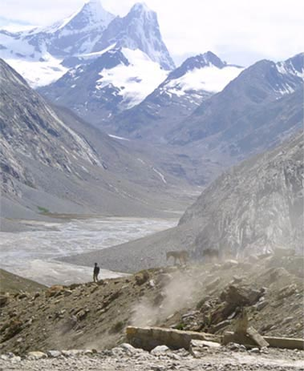
Fellowship of the Heart
Getting Started — the Four Connects, walked around the table on alternating evenings
Evening Series 2026–27 · at the Tittle home · v1.5E DRAFT
All Scripture: ESV · The Companion lesson plans carry the full scripts — these slides carry the room
1
Notes:
DECK TITLE · pre-session · DIVIDER
On screen as the room assembles on night one. All Scripture ESV; the plans carry the scripts; these slides carry the room — and these notes carry you.

Slide 2

SESSION 3
Telling Your Story I
One question, one circle, and the practice of being known — the parents tell first; the teens’ night is Week 4
Quarter 1: Connect with Self & Others
34
Notes:
S3 · pre-session · DIVIDER
On screen through dinner and as the circle forms. Greet at the door — the slide holds the room.

Slide 3
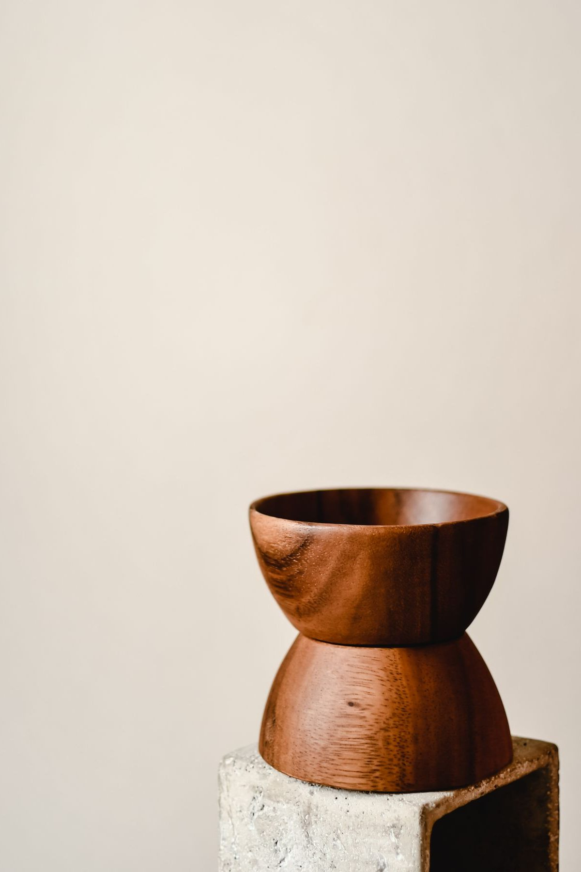
Session 3 — Tonight’s Road
1 Welcome and centering
2 Week 2 check-in
3 Psalm 139 — being known
4 Companion demo story
5 Bridge to the pairs
6 Stories in pairs
7 Merge and shared closing
8 Homework commissioning — handout + check-in partners
9 The Leader Feedback Round — both leaders
10 Closing container
35
Notes:
S3 · 7:00–8:30 · LEAD: BOTH LEADERS
BEATS:
1. Highest-risk session of the series — Handbook Section 6 re-read within 48 hours before; crisis card in every Companion pocket; pastoral/clinical backup on call 6:30–11:00.
2. Shape: open, check-in, Psalm 139, YOUR five-minute demo story, bridge, 35-minute pair storytelling (parents tell; teens witness and bless), merge, Joint Footprints, feedback, close.
3. The clock is a guide — if a block runs sixty seconds long because something true is being said, let it.
CUES: First-teller parent arranged per pair. Any parent whose story carries news their teen has not been handed talked with the Lead Companion beforehand — hold that plan.

Slide 4
Opening Container — the Eight Steps
1 Welcome — five minutes to open the container
2 Phones silenced and put away
3 Stand in a circle
4 One-word check-in — how you actually are, right now
5 Put out / bring in — set something down; bring a blessing in
6 Spoken commitment: “I am here. I am paying attention. I am willing to be moved.”
7 Opening prayer — “Holy Spirit, you are welcome here. Speak. We are listening.”
8 Sit. Begin.
36
Notes:
S3 · 7:00–7:08 · LEAD: CONTAINER HOLDER
BEATS:
1. 'Find a seat. We'll start in ninety seconds.' The settling is part of the work.
2. Speak the Aaronic blessing over the room first.
3. Frame: today the parents tell; teens, your night is next week — your work today is listening and blessing, and that is not the small half.
4. Container reminders: Safe, Present, Clear, Intentional; nothing is required; we listen and bless, we do not fix.
CUES: Spot anyone who arrived heavy — eye contact, smile, no singling out. They will know you saw them.

Slide 5

Week 2 Check-In — Heart Soil
• “Some of you journaled this week. Some of you didn’t. Both are fine.”
• One sentence about what showed up — optional, no pressure
– “‘Path soil at school’ — just one sentence. Anyone?”
• “The work is happening, whether or not we name it tonight.”
37
Notes:
S3 · 7:08–7:25 · LEAD: CONTAINER HOLDER
BEATS:
1. Ninety seconds, optional: one sentence on what the soil journaling surfaced — 'path soil at school' is enough.
2. Take 3–4 voluntary contributions; call on no one.
3. If silence: wait ten seconds, then 'Good. The work is happening, whether or not we name it today.'

Slide 6
Psalm 139 — Being Known
• Psalm 139 is the psalm of being completely known by God — and the psalmist’s response is not panic. It is wonder
• Most of us have parts we hope nobody has noticed. The psalmist invites God to look further
• The opposite of being hidden is not being exposed — it is being seen and being safe at the same time. That is what the circle is
• Tonight is a small practice of Psalm 139 — parents answer one question, with what they are willing to say
PSALM 139:23–24
“Search me, O God, and know my heart! Try me and know my thoughts! And see if there be any grievous way in me, and lead me in the way everlasting!”
38
Notes:
S3 · 7:25–7:33 · LEAD: CONTENT PRESENTER
BEATS:
1. Read Psalm 139:1–6, then 23–24, from the physical Bible. Slowly. Do not preach over the reading.
2. The psalmist is completely known and not running — his response is wonder, and he invites more: 'Search me.'
3. Land the one idea: the opposite of hidden is not exposed — it is seen and safe at the same time. That is what the circle is.
4. Today is a small practice of it: parents answer one question at the depth they choose; the circle blesses, never fixes.

Slide 7
Companion Demo Story
• The Lead Companion tells their own story — five minutes, modeling the form
• The one question: “tell the story of how you got here — today, as you are. What has shaped you into who you are today?”
• Be specific — “I grew up in a house where we didn’t do anger, it wasn’t accepted”
• Not the hero, not the victim — what happened, and where you see God in it now, looking back
• “That is the form. Parents, you’ll do this in your pair tonight. Teens, this is yours next week. Yours doesn’t have to look like mine.”
39
Notes:
S3 · 7:33–7:39 · LEAD: CONTENT PRESENTER
BEATS:
1. Tell your own five-minute story answering the one question: how you got here, and what has shaped you.
2. Be specific ('I learned to read a slammed cabinet door'), honest about one real hard place, neither hero nor victim; say where you see God in it now.
3. Close: 'That is the form. Parents, today in your pair. Teens, yours is next week. Yours doesn't have to look like mine.'
GUARD: Time it — five minutes, practiced in advance. The whole room calibrates against this demo; vague gives permission to be evasive.
SUB: The printed kitchen-table story in the plan is the founder's own. Tell YOUR story, written out this week per the pre-work — never perform John's testimony.

Slide 8
Bridge to the pairs
1 One question — how you got here, and what has shaped you. The depth is yours to choose
2 Listening — do not fix. Do not advise. Do not say “that happened to me too.” Receive, then bless
3 Nothing leaves your circle. “Not a phrase, not a name, not a story.”
• Teens — your own storytelling card goes home tonight; next Wednesday is your night
• Two or three families together, your own family stays with you — thirty-five minutes
40
Notes:
S3 · 7:39–7:40 · LEAD: CONTENT PRESENTER · TRANSITION
BEATS:
1. Hold up the cards. Three things: one question, depth is the teller's; listeners receive and bless — no fixing, advising, or 'me too'; nothing leaves the circle.
2. Pray the bridge prayer: 'Make this circle a small place where we can be known and safe at the same time.'
3. Send: families stay together; back in the main room at 5:14.
CUES: Teen storytelling cards (H3.2) go home today for Week 4. Ten or fewer — stay one circle; the arranged parent tells after the Companion.

Slide 9

Stories in pairs
• Tonight’s tellers: the parents — plus any Companion-in-Formation. The leadsanion goes first
1 Story — 5–7 minutes. The teller speaks; nobody interrupts, even the silences
2 Silence — ten seconds
3 Blessing round — one or two sentences each, teens included: “What I want to bless about your story is...”
• “Inside this pair, what is said stays in this pair. Not even back to the main room, and not back up in the car this week.”
• “When someone is telling their story... we are looking at them. We are receiving. That’s the practice.”
41
Notes:
S3 · 7:40–8:20 · LEAD: CONTENT PRESENTER · PAIRS
BEATS:
1. In each pair: the Companion tells first, then the arranged parent, then the remaining parents. 5–7 minutes per story, 10 seconds of silence, 1–2 minute blessing round.
2. Nobody interrupts a teller, even through silence. At six minutes, gentle eye contact; at seven, 'Let's land it together.'
3. Blessing starters are on the listener card; invite the teller's own teen to bless — invite, never force.
4. Short on time: compress blessings to one sentence each. Never send a parent home untold.
GUARD: Watch each teen's face during their parent's telling — weight received is a Settle Protocol matter (Handbook Section 6); quiet check-in at the next pause, and nobody leaves activated. Heavy disclosures: receive, bless, do not rush; two adults step aside after; Section 6 timelines apply.

Slide 10
Merge and Shared Closing
• What happened in your circle stays in your circle
• One word — just one — about what tonight was like for you. You can pass
– “Heavy.” “Seen.” “Surprising.” “Tender.” “Hard.” Whatever the true word is
• “Each of you brought something true into this room tonight, and each of you received something true. That’s rare. It’s also the kind of room God shows up in.”
42
Notes:
S3 · 8:28–8:30 · LEAD: CONTAINER HOLDER
BEATS:
1. Reconvene; the room's texture will be different than at 4:38 — honor it, do not break it with energy.
2. One word each on what today was like; pass allowed. Receive with eye contact and a small nod — no 'great', no commentary.
3. Close: 'Each of you brought something true and received something true. That's rare. It's also the kind of room God shows up in.'
GUARD: Do not ask anyone to share what was said — pair content stays in the pair.

Slide 11

Homework — Two Weeks, Four Parts — Joint Footprints
• Joint Footprints — each parent-and-teen pair sits together once this week. Twenty minutes total
• Not in the car, not at dinner, not while the TV is on. Phones away
1 Five minutes telling the footprints question — where you grew up, who shaped you, what places and people made you who you are
2 The listener asks one or two follow-ups, then one sentence: “What I love about your footprints is...”
3 Then swap — the other person tells, the first listens and blesses
• The morning question and evening journal note continue daily
43
Notes:
S3 · 8:20–8:24 · LEAD: CONTENT PRESENTER
BEATS:
1. Parent Co-Companion leads. One handout per family (H3.5).
2. The practice: parent and teen sit together twenty minutes this week — not the car, not the TV, phones away. Five minutes of footprints each way; listener asks one or two follow-ups, then one sentence: 'What I love about your footprints is...'
3. Two rules: the teen discloses only what they are ready to (their telling night is next week); the parent does not turn it into a lecture.

Slide 12
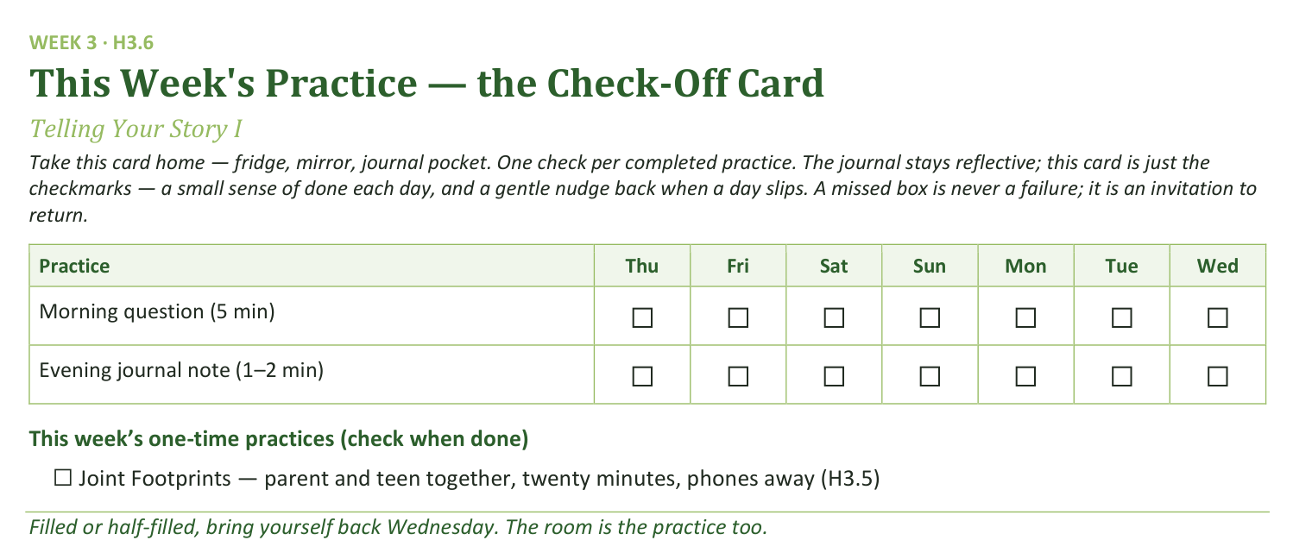
Your Take-Home Card — This Session’s Practice
Handed out now — fridge, mirror, journal pocket.
44
Notes:
S3 · 8:20–8:24 · LEAD: CONTENT PRESENTER
BEATS:
1. Check-off card (H3.6): morning question and evening note daily; Joint Footprints once.
2. Confirm every teen leaves with their storytelling card (H3.2) — the writing for next week starts today.
CUES: Rides inside the practice block.

Slide 13
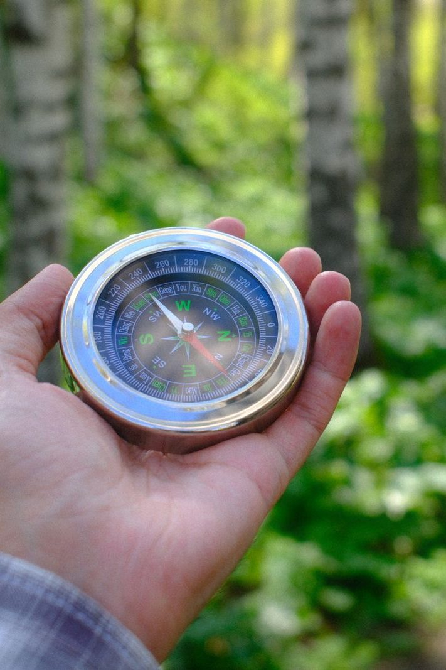
The Leader Feedback Round
• Two rounds, same as every session — the container holder first, then the content presenter: three things each
– “What I think went well tonight: ______”
– “What I’d do differently next time: ______”
– “If I were to teach tonight’s process to someone, I would tell them: ______”
• Then the room — the same two questions about tonight
• The leaders receive without defending — “thank you” is the whole response
45
Notes:
S3 · 8:24–8:28 · LEAD: BOTH LEADERS
BEATS:
1. Your three things first: went well; do differently; what I'd tell someone teaching today's process.
2. Then the room's two questions; two or three voices is plenty.
3. Receive without defending — 'thank you' is the whole response.
CUES: May be dropped if the room's energy needs something else; twice running goes to the team debrief.

Slide 14
Closing the Container + Aaronic Blessing
• We close the way we opened — the container, six steps:
1 Stand again — same circle, same posture as the open
2 One-word landing — compare it to your opening word
3 The one thing you are taking from tonight
4 The one practice — committed aloud, or modified to one you will actually keep
5 Blessings — specific, witnessed, short
6 Closing prayer — and the Aaronic blessing, spoken over each other, face to face
THE AARONIC BLESSING — NUMBERS 6:24–26
“The Lord bless you and keep you;
the Lord make his face to shine upon you, and be gracious to you;
the Lord lift up his countenance upon you, and give you peace.”
46
Notes:
S3 · 8:28–8:30 · LEAD: CONTAINER HOLDER
BEATS:
1. Restate the container hard: your own story goes home with you; nobody else's does — not to a sibling, a friend, or a spouse not in this room.
2. Name the help: reach out if today sits heavy — email, text, knock; the Crisis Quick-Reference Card is real and someone is there.
3. Aaronic blessing. 'Go gently this week.'
CUES: Do not pack up — stay accessible ten minutes; the work after the closing is sometimes the work.

